Slide 1
HOW TO Build a successful kickstarter campaign
Tristan Dresbach
NYC Data Science Academy
10/18/2018

Slide 2
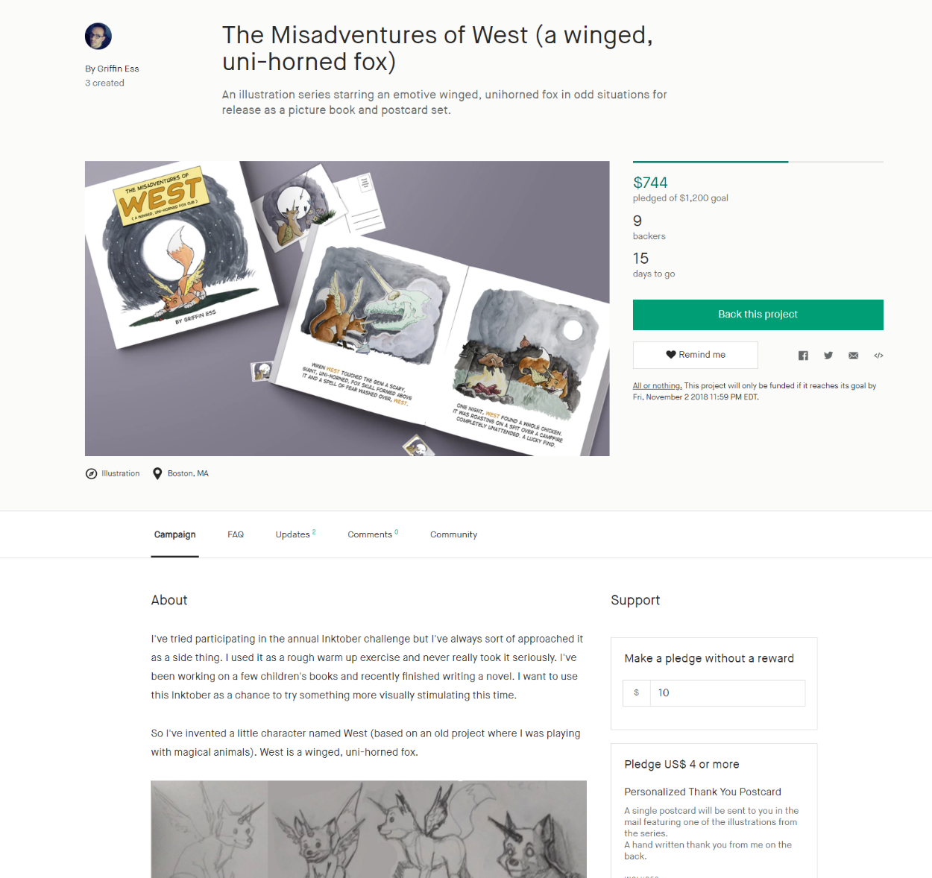
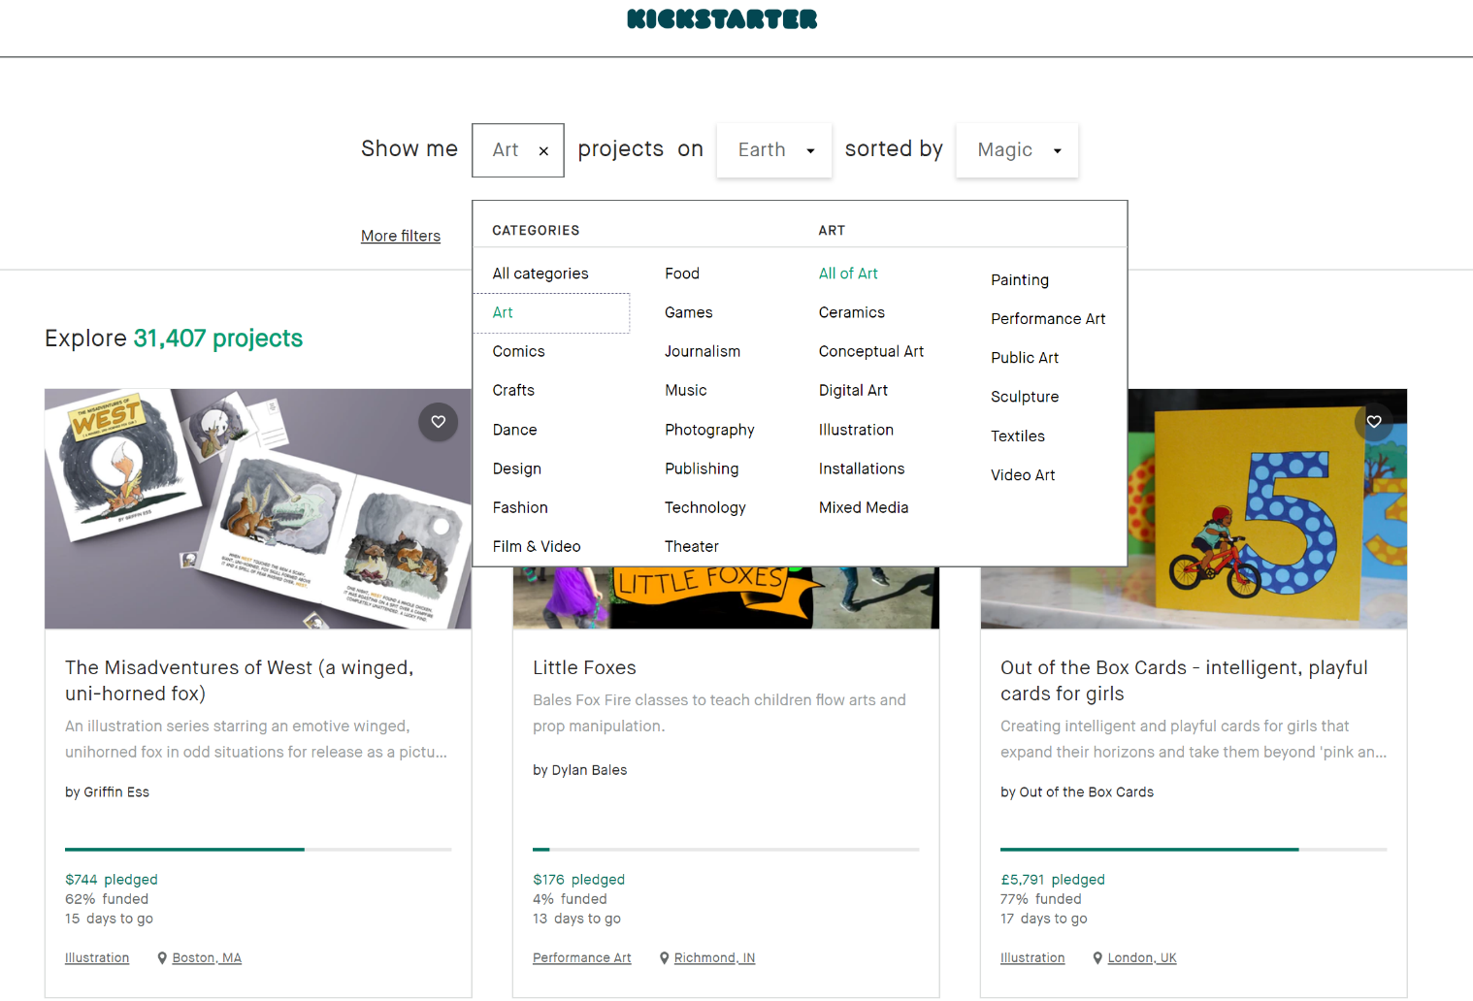
Web scraping process a) Setting up scrapy

Slide 3
Web scraping process B) Challenges
ISSUES:
JavaScript Element
3 Types of Projects
IP Ban
SOLUTIONS:
ScrapySplash
Testing all XPaths
Ran on alternate machine

Slide 4
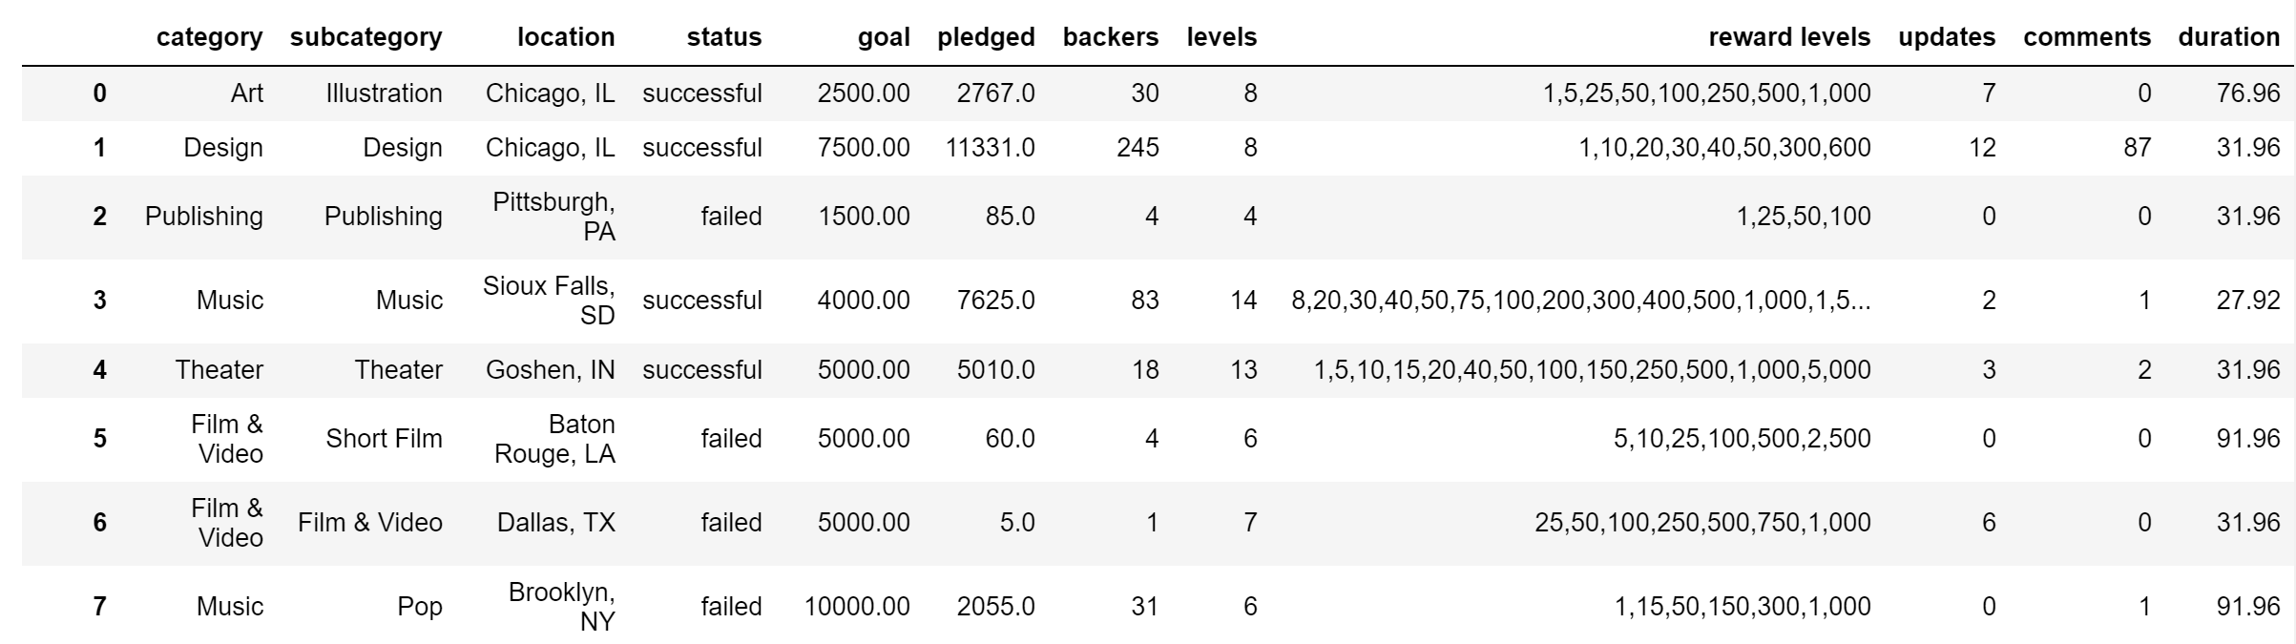
DATA OVerview a) Data Frame
What we want to explore: success = (amount funded / goal amount) * 100

Slide 5
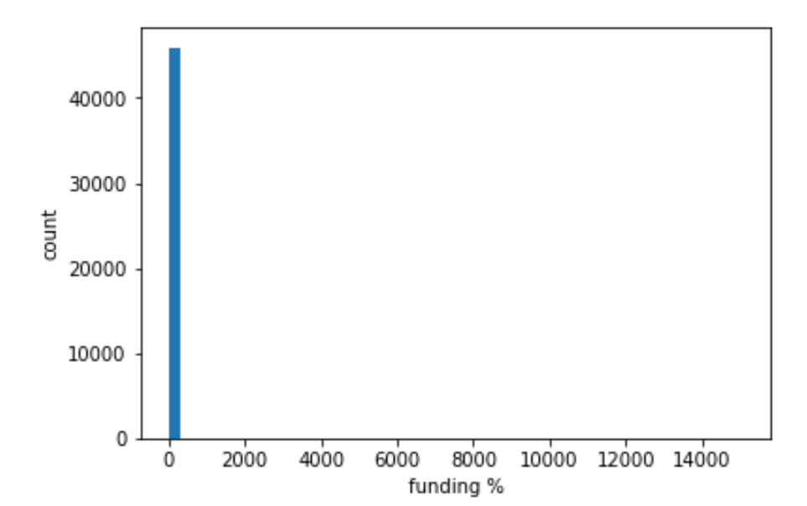
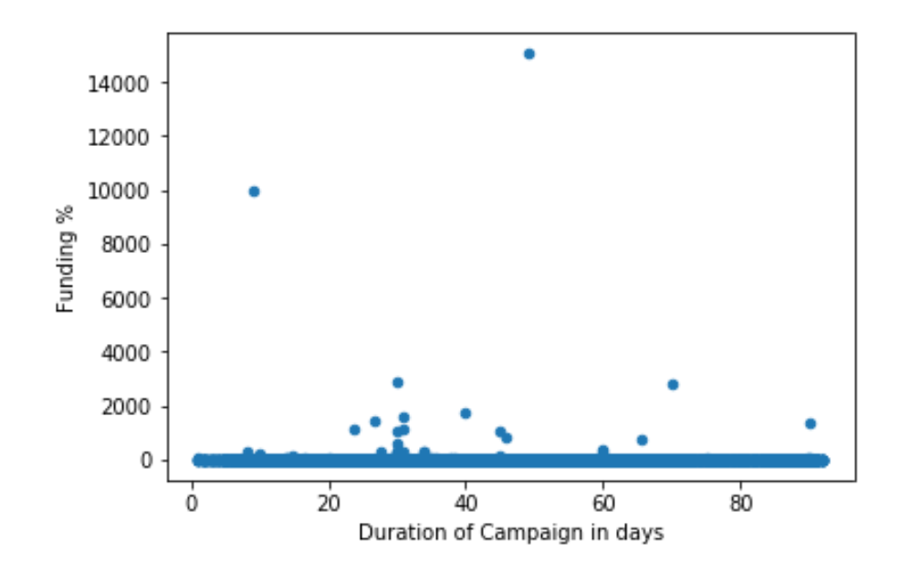
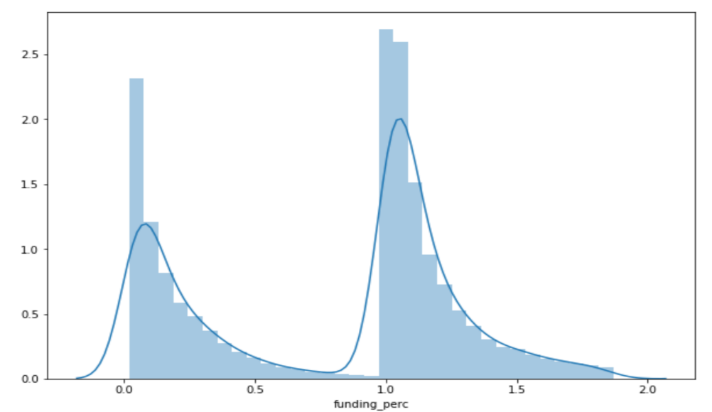
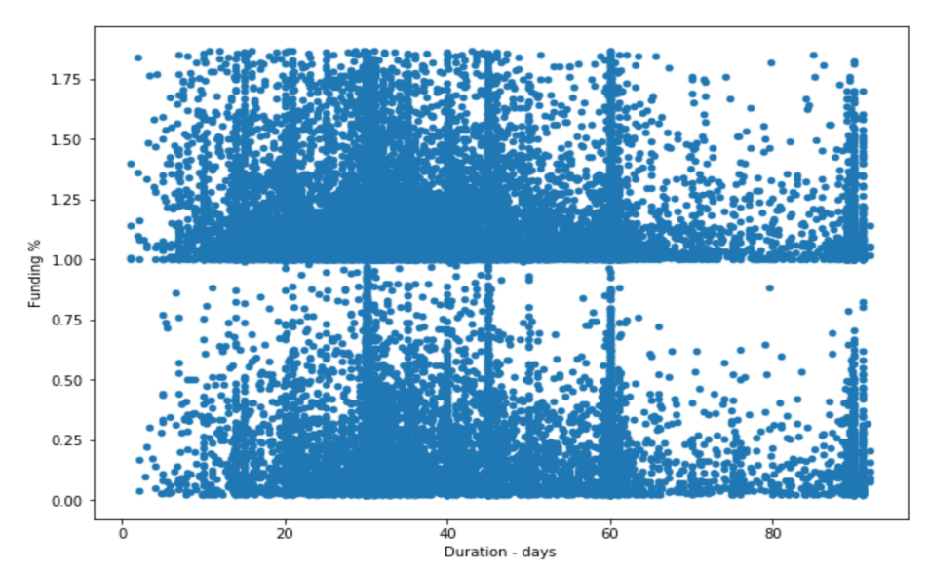
DATA OVerview B) Examining Success rates
Need to do an IQR transformation to get rid of outliers
Before IQR
After IQR

Slide 6
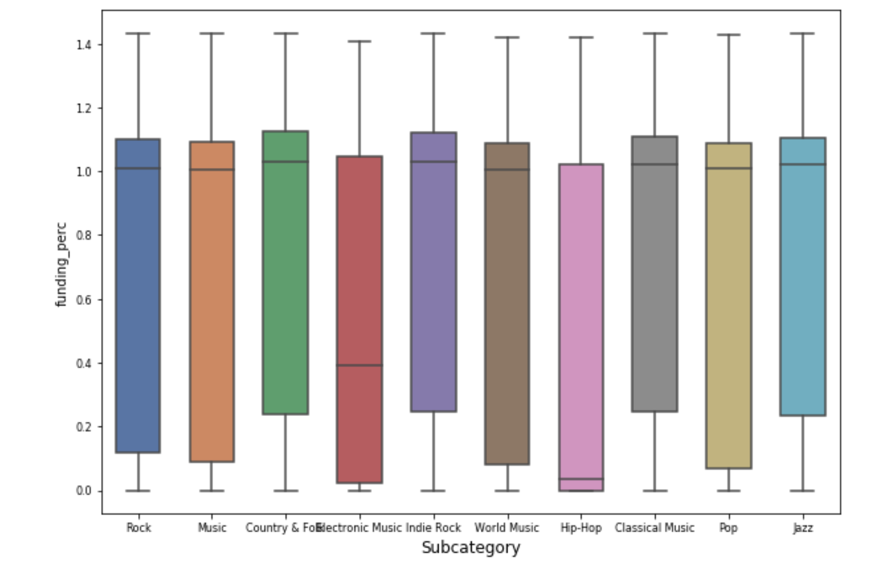
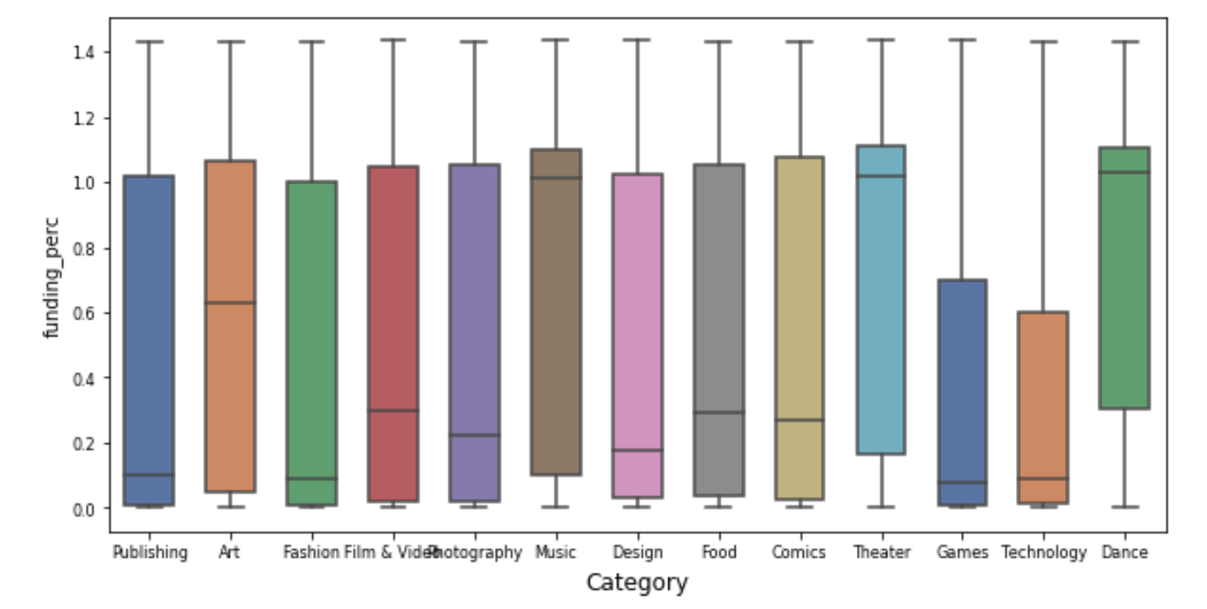
DATA ANALYSIS A) Main project characteristics

Slide 7
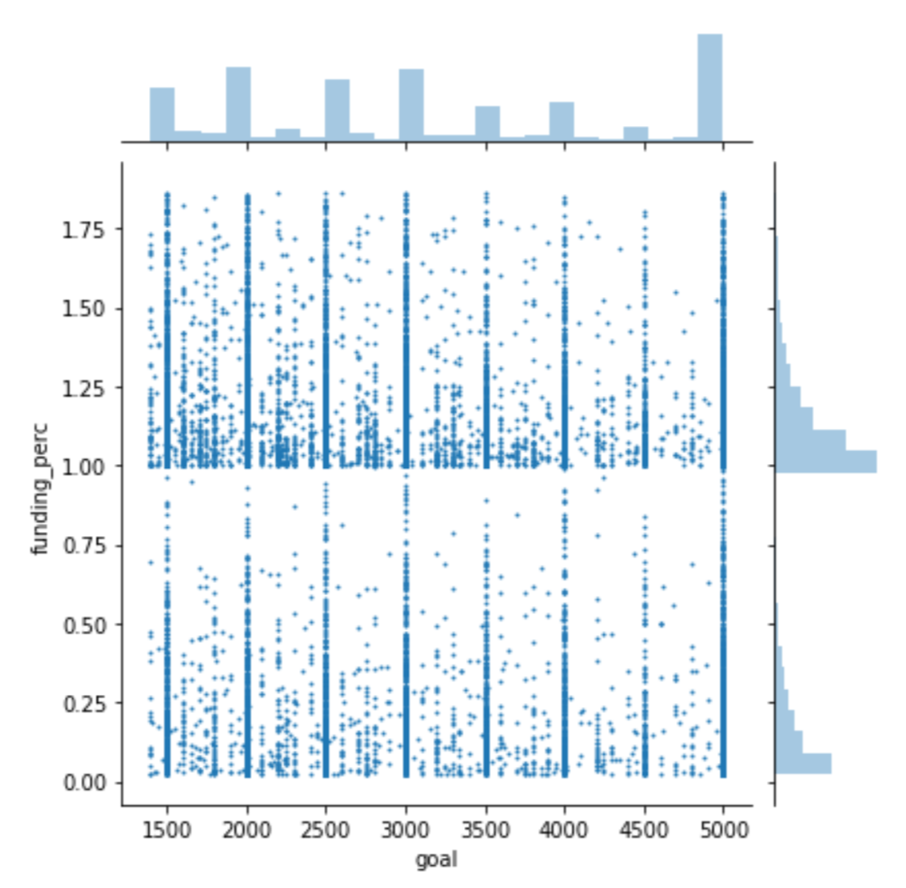
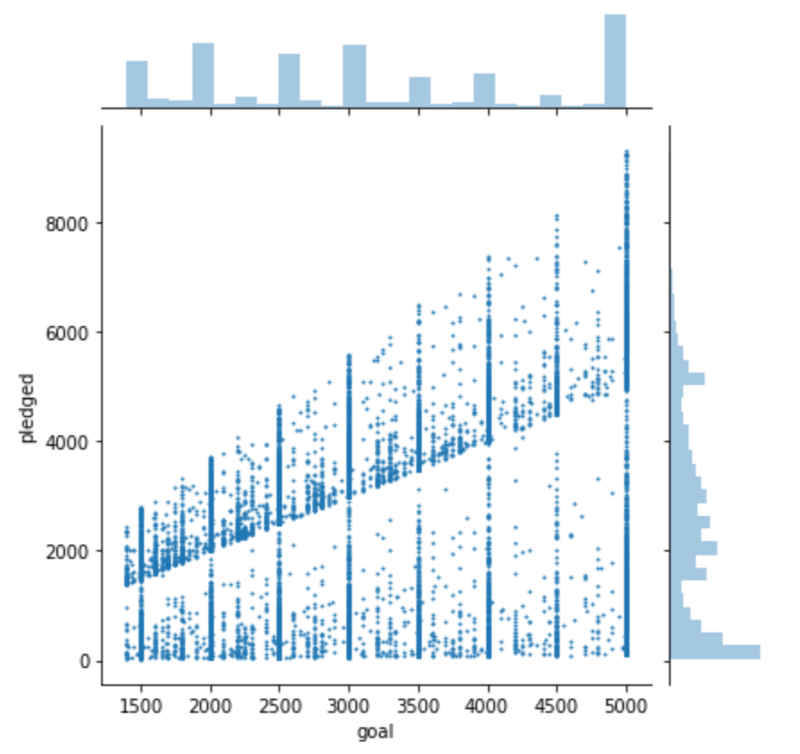
DATA ANALYSIS A) Main project characteristics

Slide 8
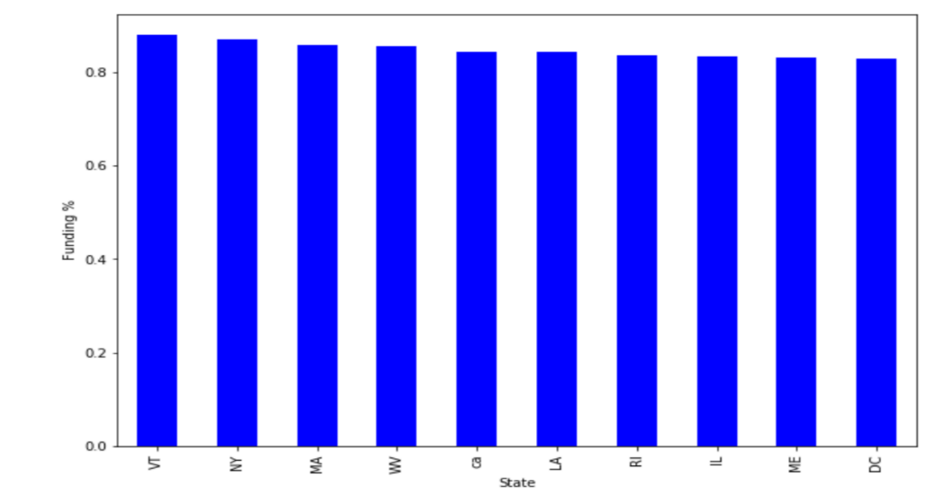
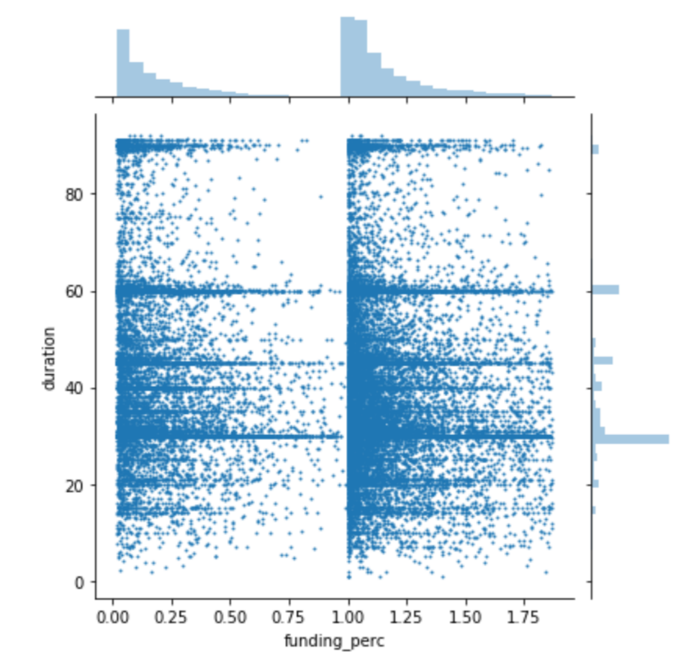
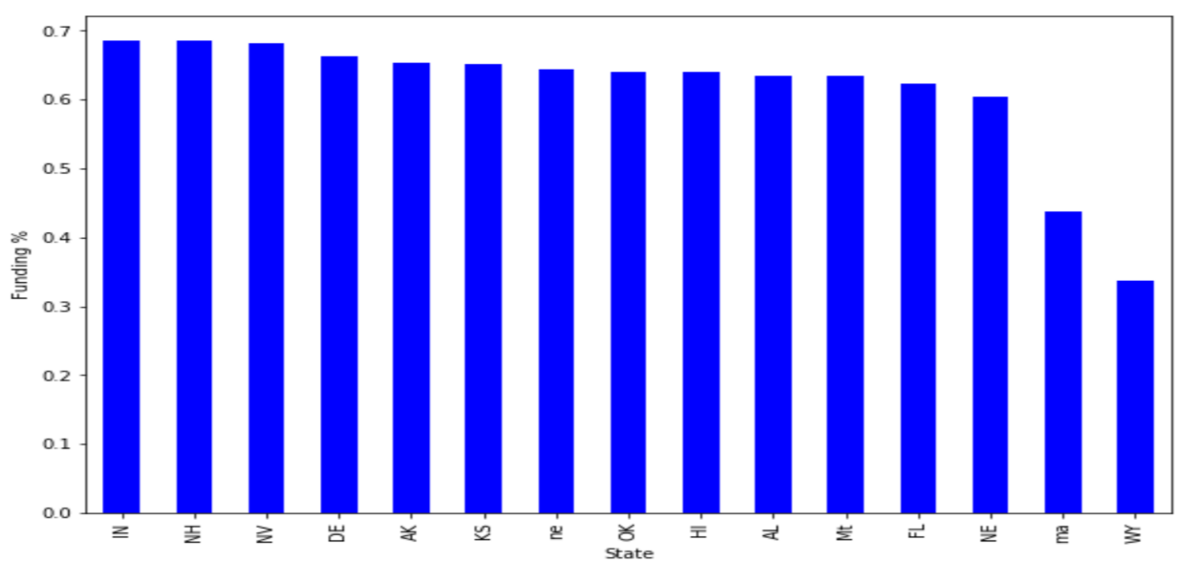
DATA ANALYSIS A) Main project characteristics

Slide 9
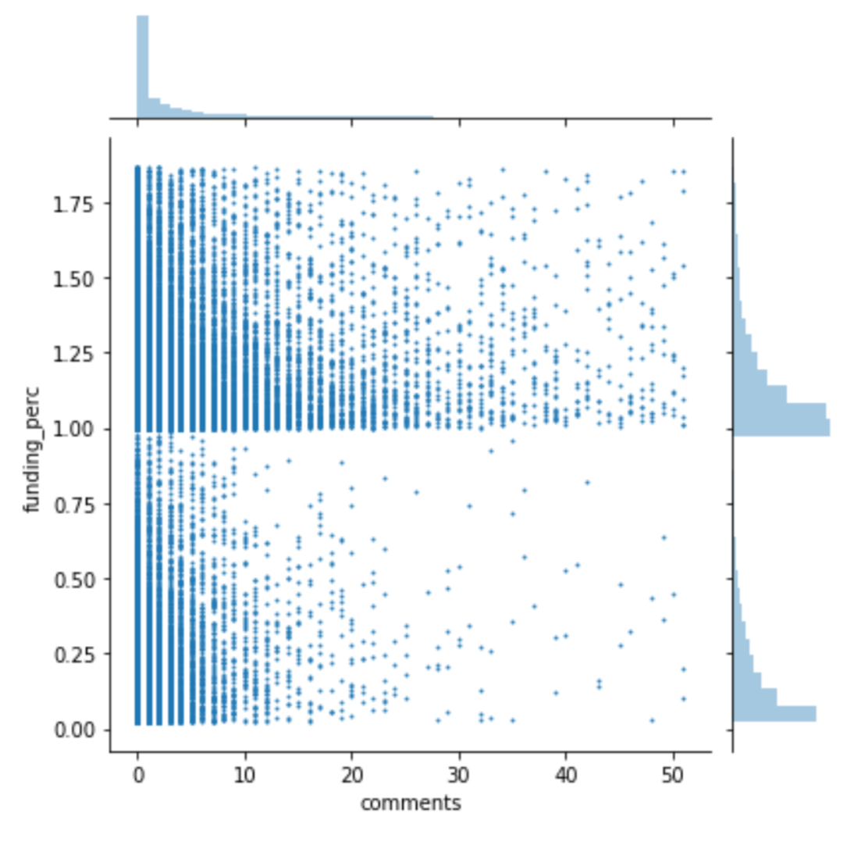
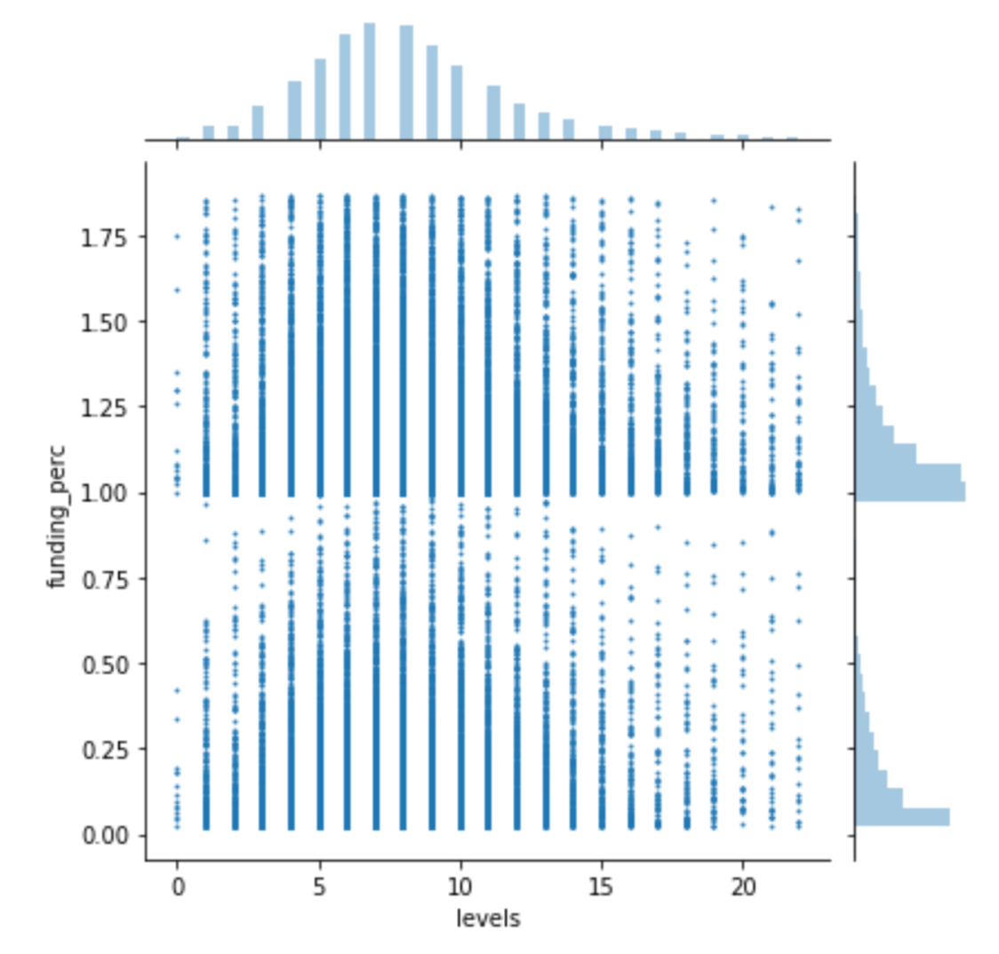
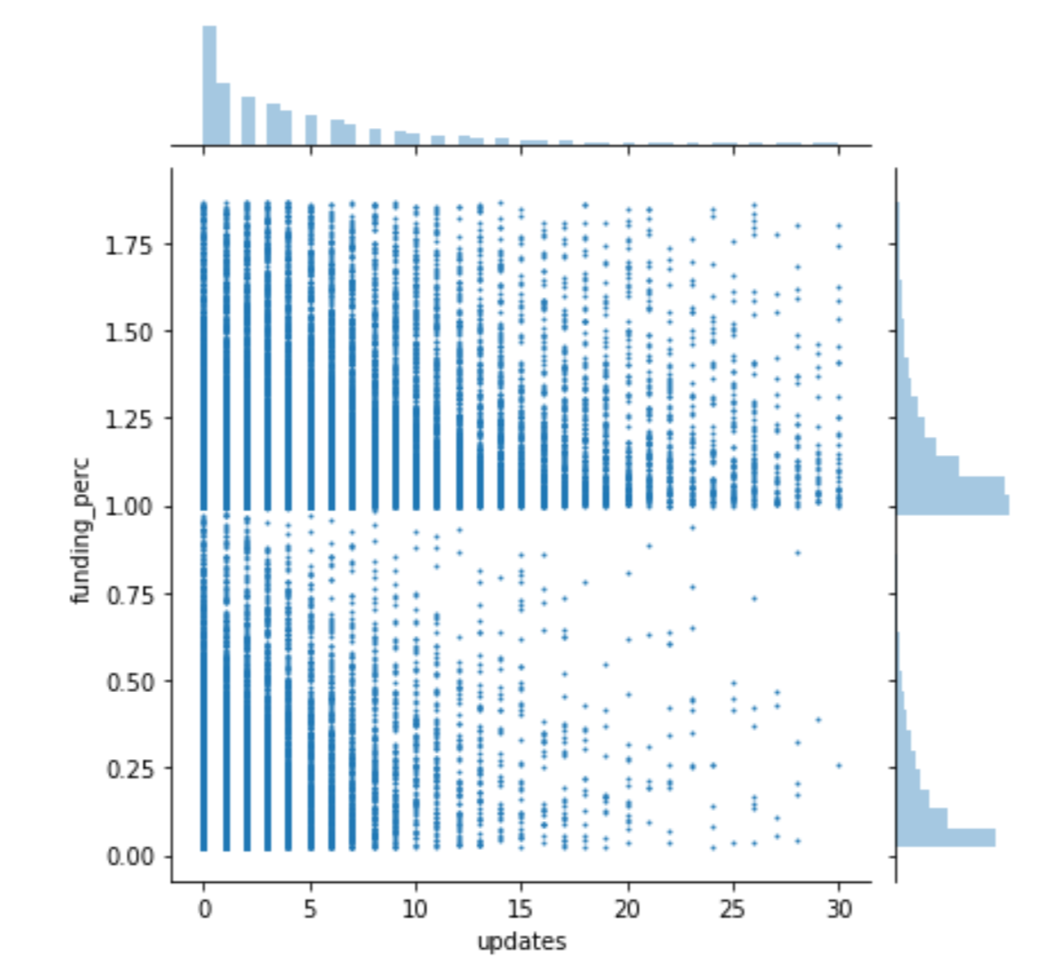
DATA Analysis B) Additional Characteristics

Slide 10
Future direction
Obtain more data: at least 200 rows / subcategory
Make scrapy code more efficient to minimize time taken to scrape
Build a model to predict the success of a project

